Slide 1
Machine Learning on Mushrooms Dataset
ML1 Project
- Presenter – Dhiraj Ambure (April 2020 batch)

Slide 2
Agenda
Problem Statement
Understanding Dataset
Data Processing
EDA
Dependent and Independent Variables
Model Creation Sequence
Train-Test Split
Scaling
Modeling
Model Evaluation
AUC-ROC Curve for Different Models
Compare Metrics Scores
Conclusions
Thank You

Slide 3
Problem Statement
What types of machine learning models perform best on this dataset?
Which features are most indicative of a poisonous mushroom?

Slide 4
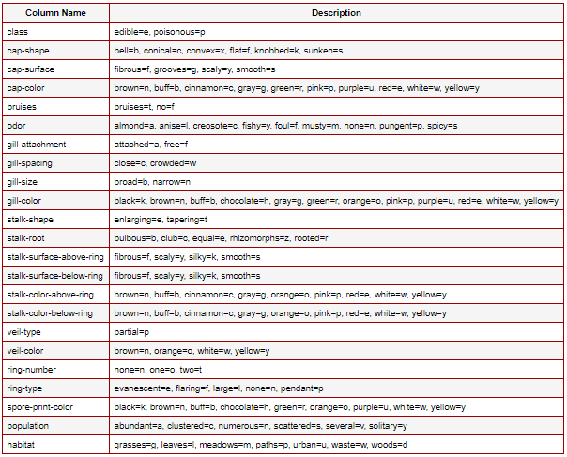
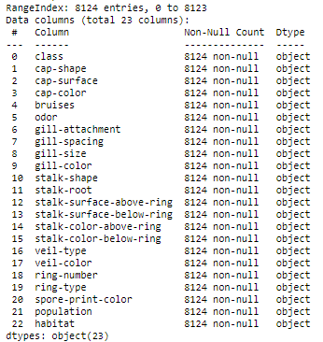
Understanding Dataset
There are total 8124 records (Rows) and 23 columns in original dataset, all of them are categorical column
There seems to be no missing value in dataset

Slide 5
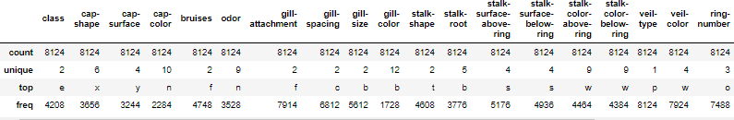
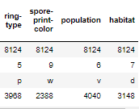
Understanding Dataset
All columns in given dataset are categorical
All columns have only alphabets as data, these alphabets have a specific meaning related to that column
There is a class column which segregates the mushrooms in 2 types, Edible and Poisonous
Mushrooms basically have 5 physical properties such as, Cap, Gill, Stalk, Veil & Ring

Slide 6
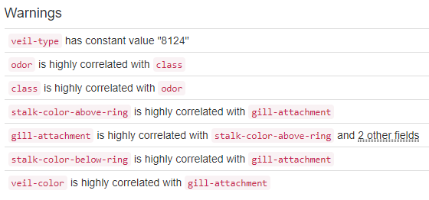
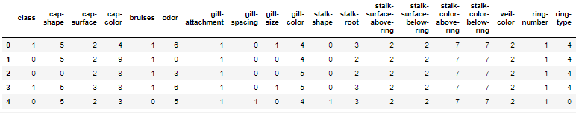
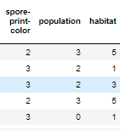
Data Processing
Pandas Profiling
Veil-type has only 1 type of data, thus we can drop it
All the data is categorical, hence we need to perform Label-Encoding
This will help Supervised machine learning algorithms to operate better on labels

Slide 7
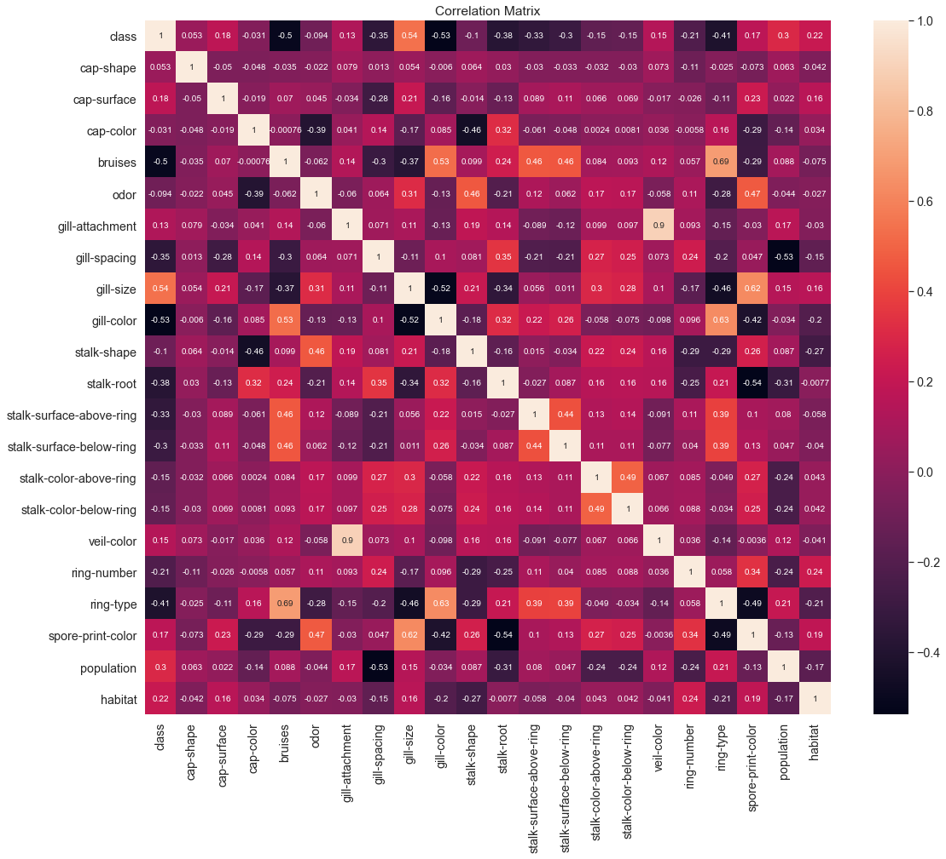
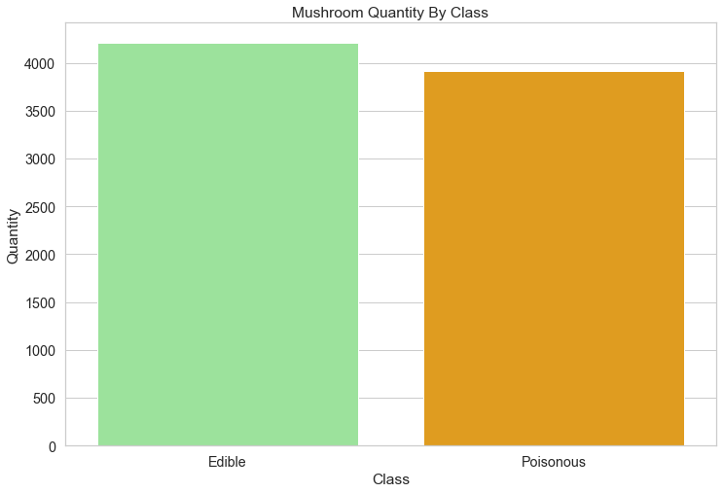
EDA
Class & Odor are highly correlated
Gill-attachment is highly correlated with stalk-color-above-ring, stalk-color-below-ring & veil-color

Slide 8
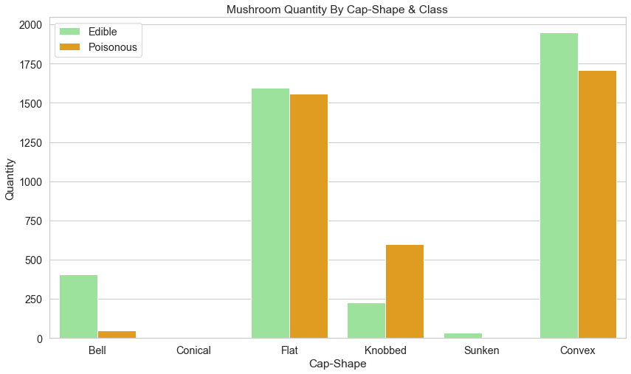
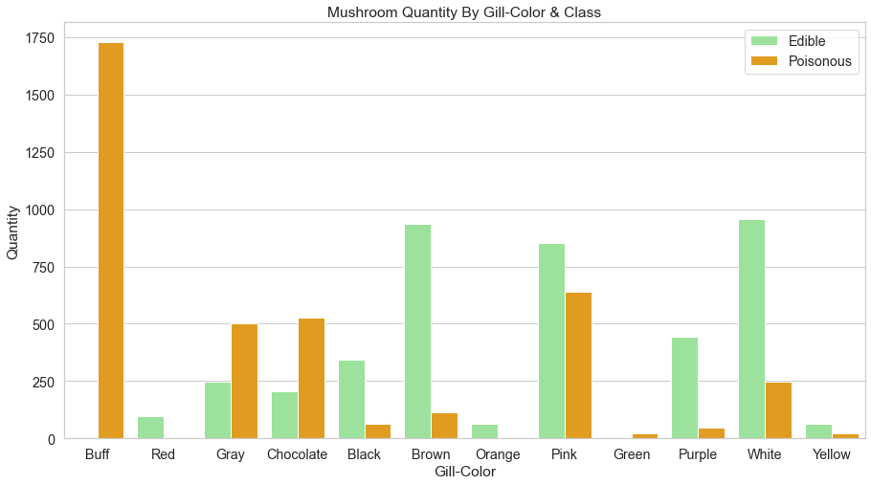
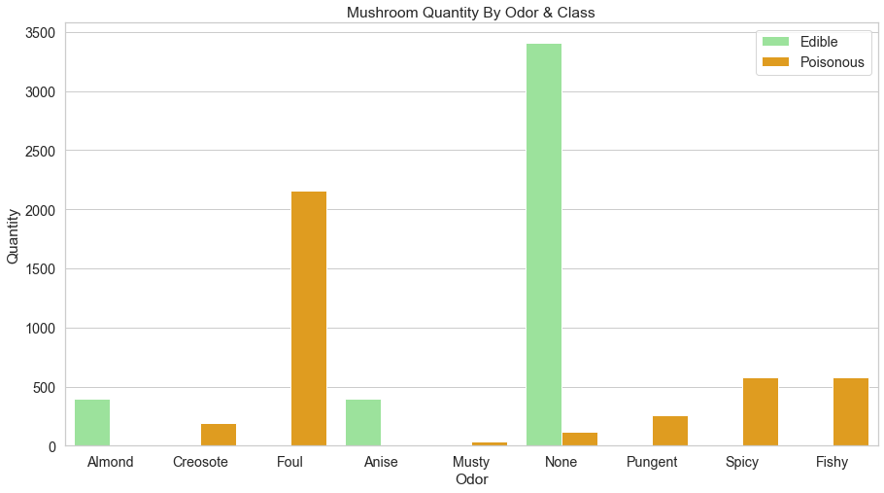
EDA
There are more Flat & Convex Cap-shape Mushrooms
Mushrooms with Bell shaped caps are more likely to be edible
Mushrooms without odor, Almond & Anise odor are Edible
Mushrooms with Buff gill-color are Poisonous; Brown & White gill-color are Edible

Slide 9
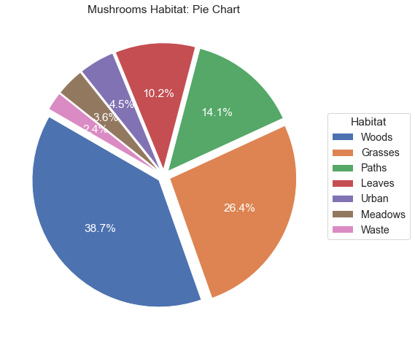
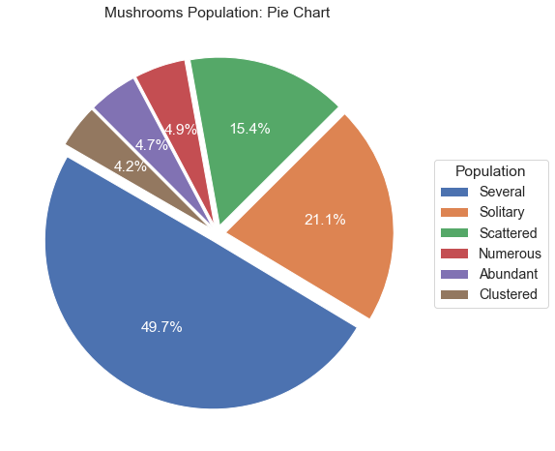
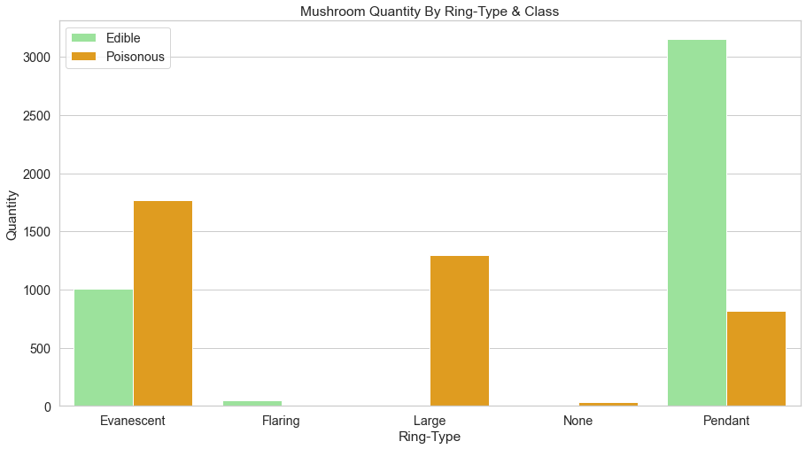
EDA
Mushrooms found in woods are more in numbers
Population of Several mushroom is more
Mushrooms having Pendant Ring-type are edible
Large ring-type mushrooms are poisonous

Slide 10
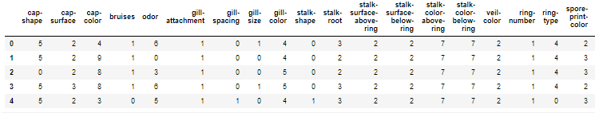


Dependent and Independent Variables
First split the data into explanatory variables (X) & target variable (Y)
To predict if mushroom is Edible or Poisonous
Y = ‘class’ column
X = All the columns in given data set except ‘class’
X Variables
Y Variable

Slide 11
Model Creation Sequence
Model creation sequence is as below:
Train-Test Split
Scaling on explanatory variables
Construct the model
Model Evaluation
Train-Test Split
Splitting the data in 80/20; 80% training set (6500 records) & 20% test set (1624 records)
Splitting is done using train_test_split() function of model_selection sub-library in scikit learn library

Slide 12

Scaling
Scaling on explanatory variables
Scaling can be done in two ways
Standard Scaling
Min-Max Scaling
We are doing Standard Scaling, by using StandardScaler class from sklearn.preprocessing library
Both Train & Test set of explanatory variables are scaled
Scaling is done in 2 steps
Fit (fit() function) – finds the multiplication factor to perform scaling
Transform (transform() function) – executes the multiplication

Slide 13
Modeling
As the target variable is categorical, we will use classification models.
We will use following models and perform model evaluation to decide best model to use
Logistic Regression
Decision Tree Classifier
Random Forest Classifier
Decision Tree Classifier with GridSearchCV
Random Forest Classifier with RandomizedSearchCV
Libraries to be used

Slide 14






Logistic Regression
Model
Intercept & Coefficients values
Model Evaluation

Slide 15
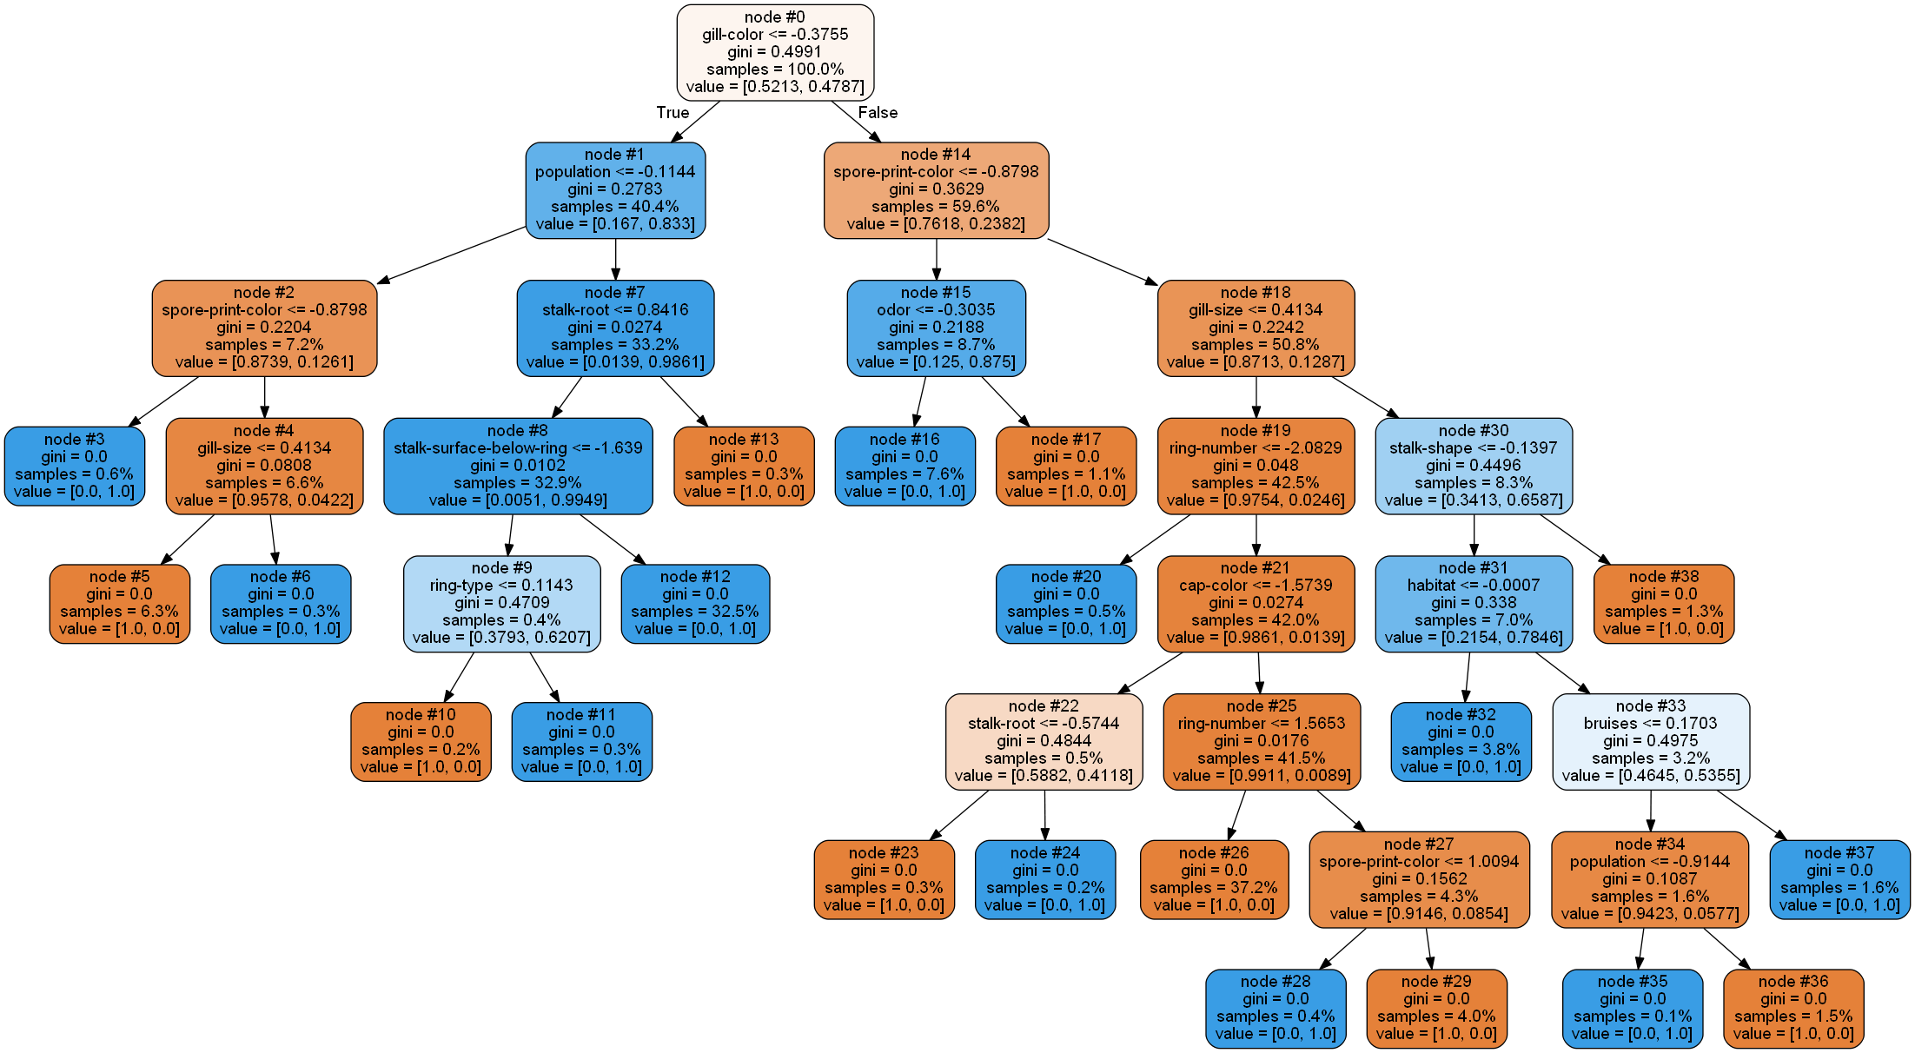
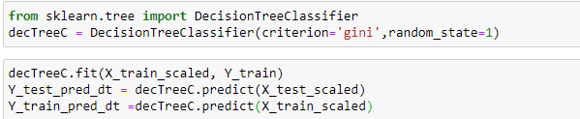





Decision Tree Classifier
Model
Model Evaluation
Accuracy Score

Slide 16
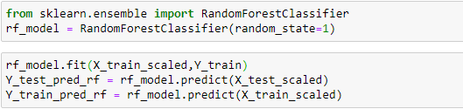
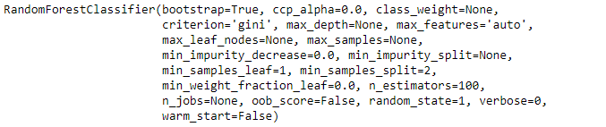
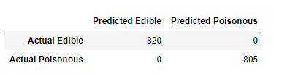

Random Forest Classifier
Model
Model Evaluation
Accuracy Score

Slide 17
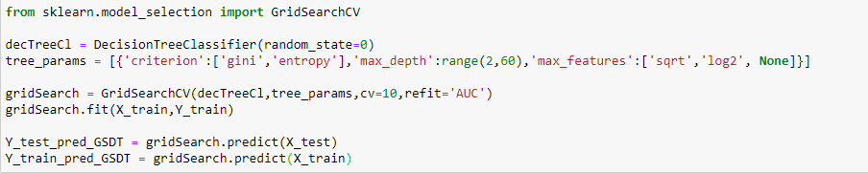
Decision Tree Classifier with GridSearchCV
Model
Model Evaluation

Slide 18
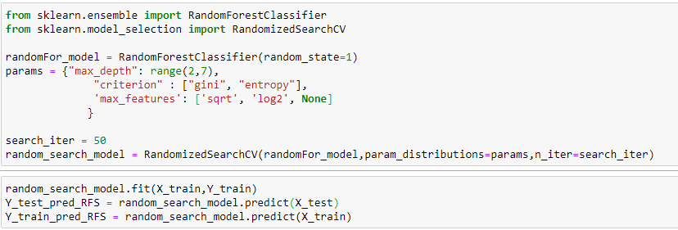





Random Forest Classifier with RandomizedSearchCV
Model
Model Evaluation

Slide 19
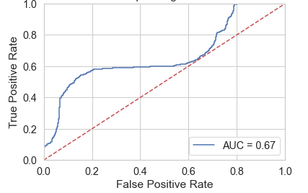
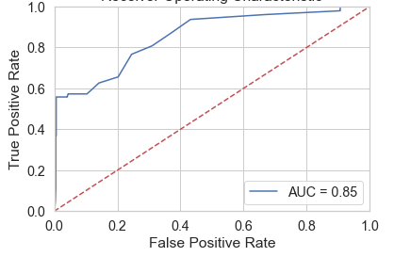
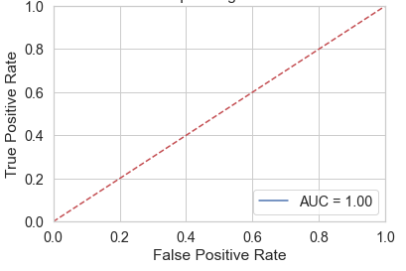
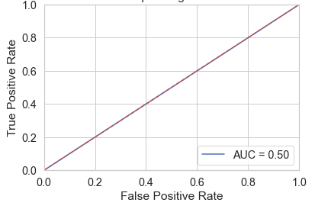
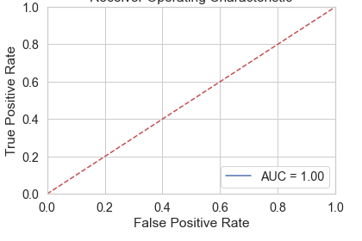
AUC-ROC Curve for Different Models
Logistic Regression
Random Forest
Random Forest with RandomizedSearchCV
Decision Tree
Decision Tree with GridSearchCV

Slide 20
Compare Metrics Scores
From the comparison between different scores, we can say that Decision Tree using GridSearchCV for Hyper-Parameter Tuning is the best fit model
Random Forest with RandomizedSearchCV for Hyper-Parameter tuning also produced good scores
Model | Accuracy | Confusion Matrix | Precision | Recall | F1 Score | AUC
Logistic Regression | 0.9587 | 0.9526 | 0.9584 | 0.9453 | 0.9518 | 0.67
Decision Tree | 1.0 | 1.0 | 1.0 | 1.0 | 1.0 | 0.50
Random Forest | 1.0 | 1.0 | 1.0 | 1.0 | 1.0 | 0.85
Decision Tree with GridSearchCV | 1.0 | 1.0 | 1.0 | 1.0 | 1.0 | 1.0
Random Forest with RandomizedSearchCV | 0.9993 | 0.9993 | 0.9987 | 1.0 | 0.9993 | 1.0

Slide 21
Conclusions
The important features of mushrooms to identify that it is safe to eat are as follows :-
Odor – None, Almond & Anise are edible and creosote, foul, musty, pungent, spicy and fishy are poisonous.
Gill Size – Narrow are Poisonous.
Rings – Whether large or absent.
Spore print colour – Brown and Black are mostly edible & White, Chocolate are poisonous
Population – Available in several places.
Habitat – Grown on grasses, leaves, woods, path and urban.
From the comparison between scores of different evaluation metrics, we can say that following ML algorithms are best fit
Decision Tree using GridSearchCV for Hyper-Parameter Tuning
Random Forest with RandomizedSearchCV for Hyper-Parameter Tuning

Slide 22

Thank You!!!!!!!!!

